Slide 1


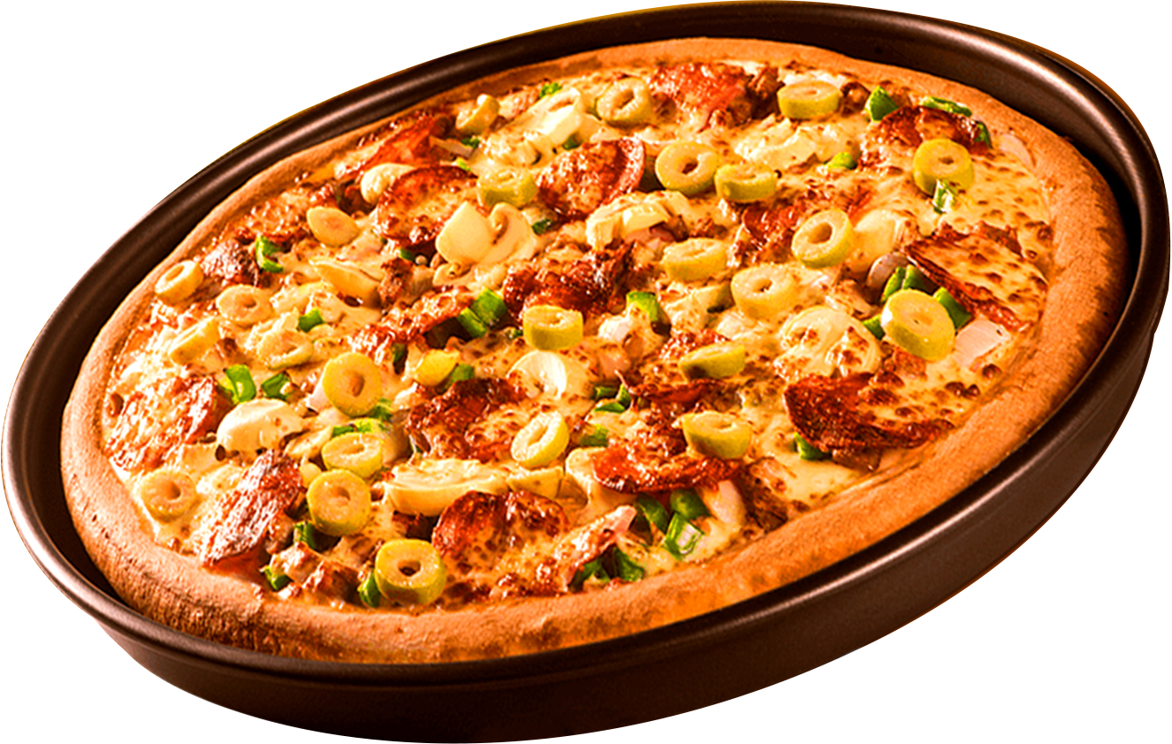
Where Every Slice is a Taste of Perfection
WELCOME TO
PIZZA RESTO
ORDER
NOW
Start Your Slide

Slide 2
HELLO!!
I am Shibin, and I am currently working on a project based on SQL, focusing on Pizza Sales Data Analysis. The aim of this project is to explore and analyze pizza sales data using SQL queries to gain insights such as total sales, most popular pizza types, peak order times, and customer preferences. This project helps in understanding how structured query language (SQL) can be used effectively for data analysis in real-world business scenarios like restaurant sales management.

Slide 3
QUESTIONS
1. Retrieve the total number of orders placed.
2. Calculate the total revenue generated from pizza sales.
3. Identify the highest-priced pizza.
4. Identify the most common pizza size ordered.
5. List the top 5 most ordered pizza types along with their quantities..
BASIC

Slide 4
QUESTIONS
Join the necessary tables to find the total quantity of each pizza category
ordered.
2. Determine the distribution of orders by hour of the day.
3. Join relevant tables to find the category-wise distribution of pizzas.
Group the orders by date and calculate the average number of pizzas
ordered per day.
5. Determine the top 3 most ordered pizza types based on revenue..
INTERMEDIATE

Slide 5
QUESTIONS
Calculate the percentage contribution of each pizza type to total revenue.
Analyze the cumulative revenue generated over time.
Determine the top 3 most ordered pizza types based on revenue for each pizza category.
ADVANCED

Slide 6

Basic
QUESTIONS

Slide 7
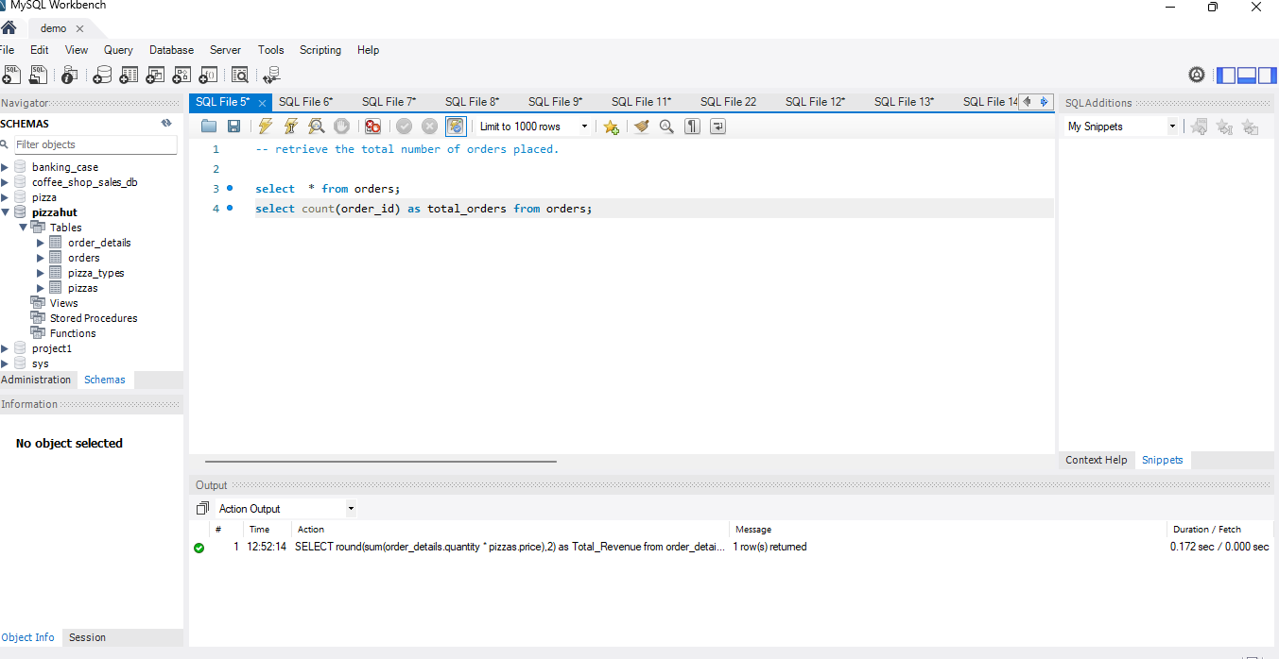
1 . Retrieve the total number of orders placed.
Query:
Output:
ORDER
NOW

Slide 8
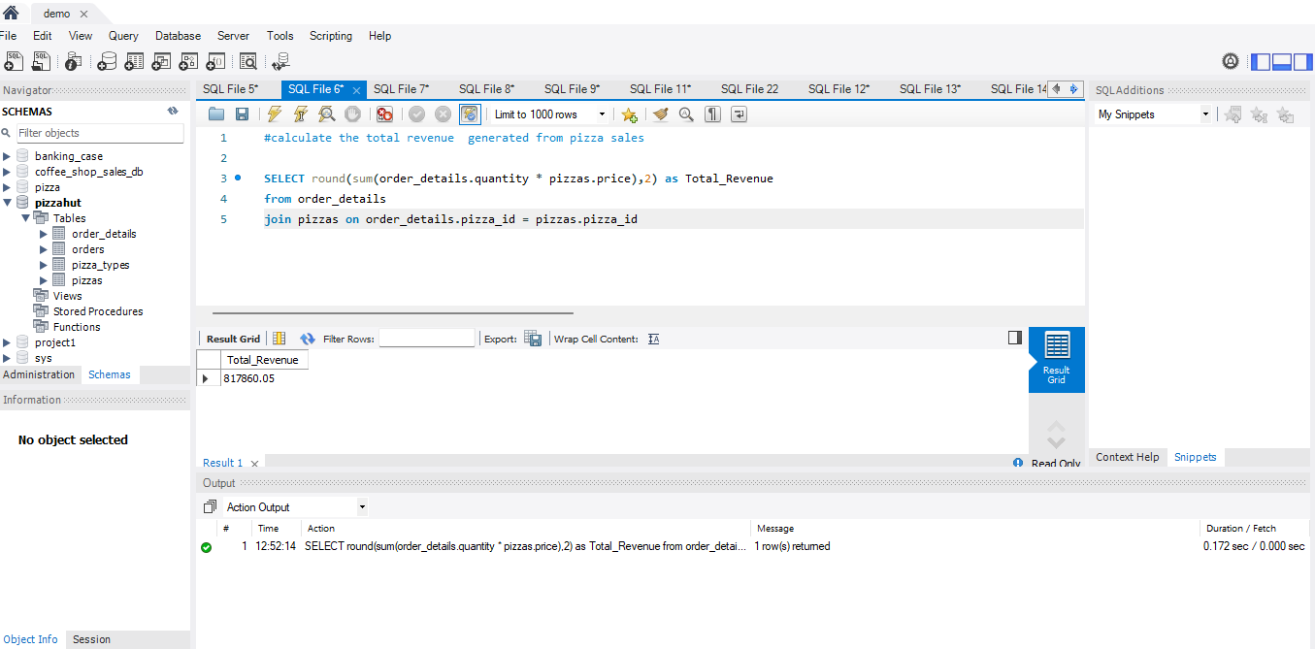
2 . Calculate the total revenue generated from pizza
sales.
.
Query:
ORDER
NOW
Output:

Slide 9
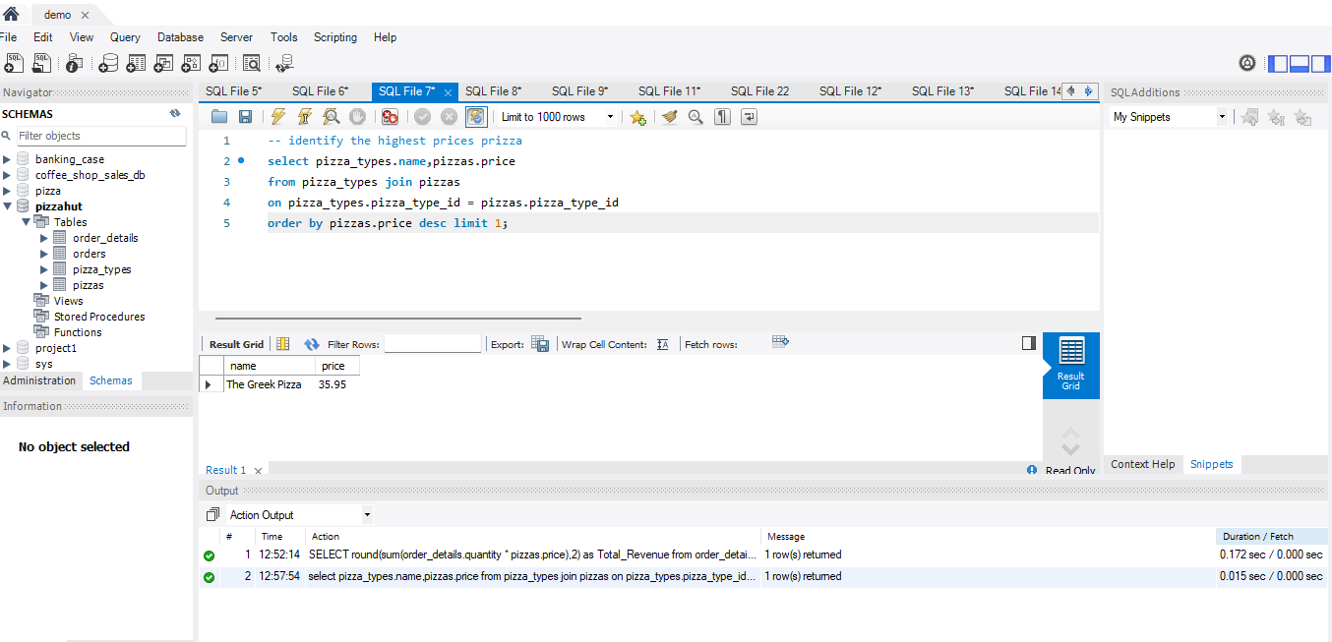
3 . Identify the highest-priced pizza.
.
Query:
ORDER
NOW
Output:

Slide 10
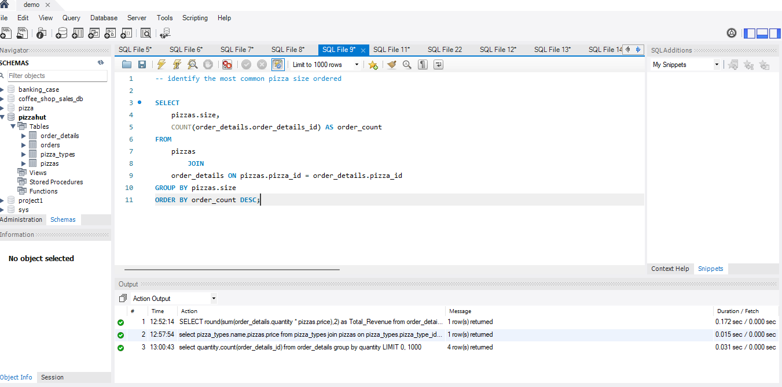
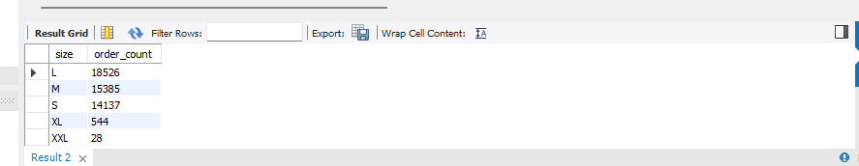
4 . Identify the most common pizza size ordered.
.
Query:
ORDER
NOW
Output:

Slide 11
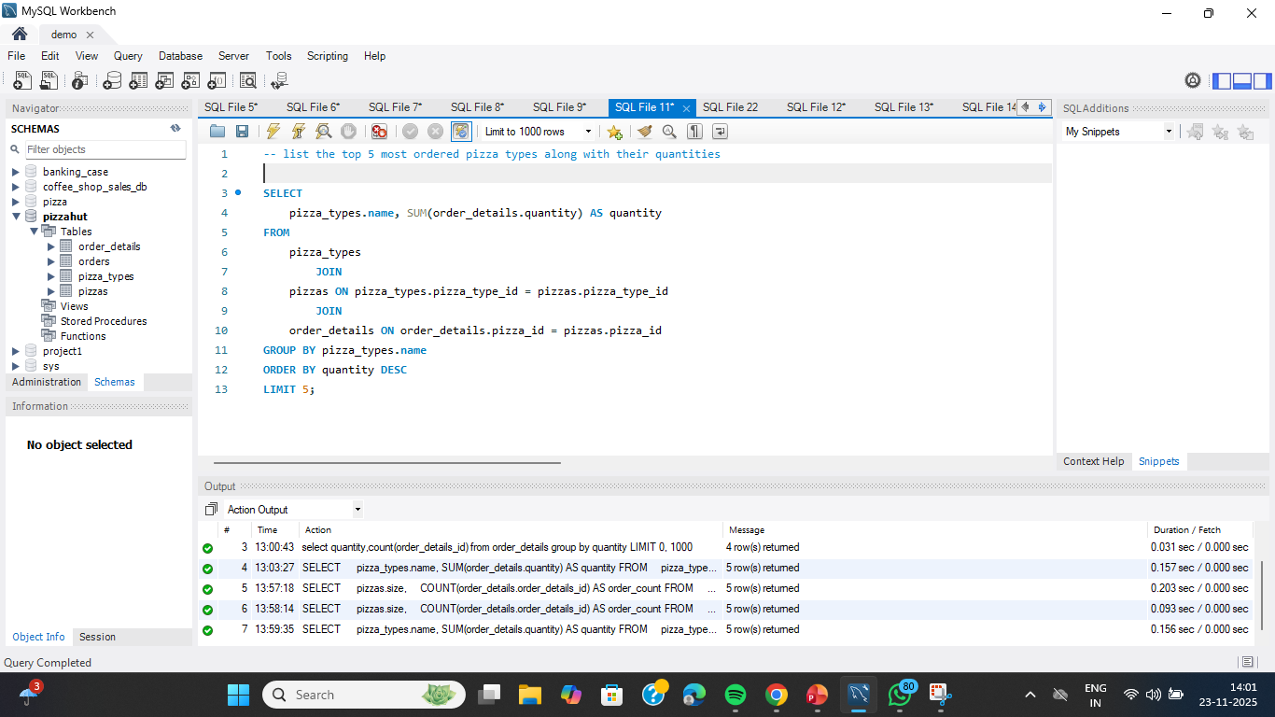
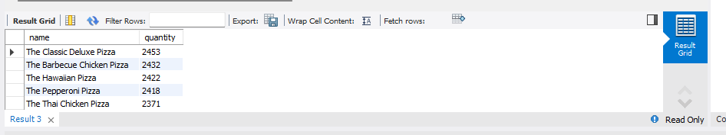
5 . List the top 5 most ordered pizza types along with
their quantities...
Query:
ORDER
NOW
Output:

Slide 12
intermediate QUESTIONS

Slide 13
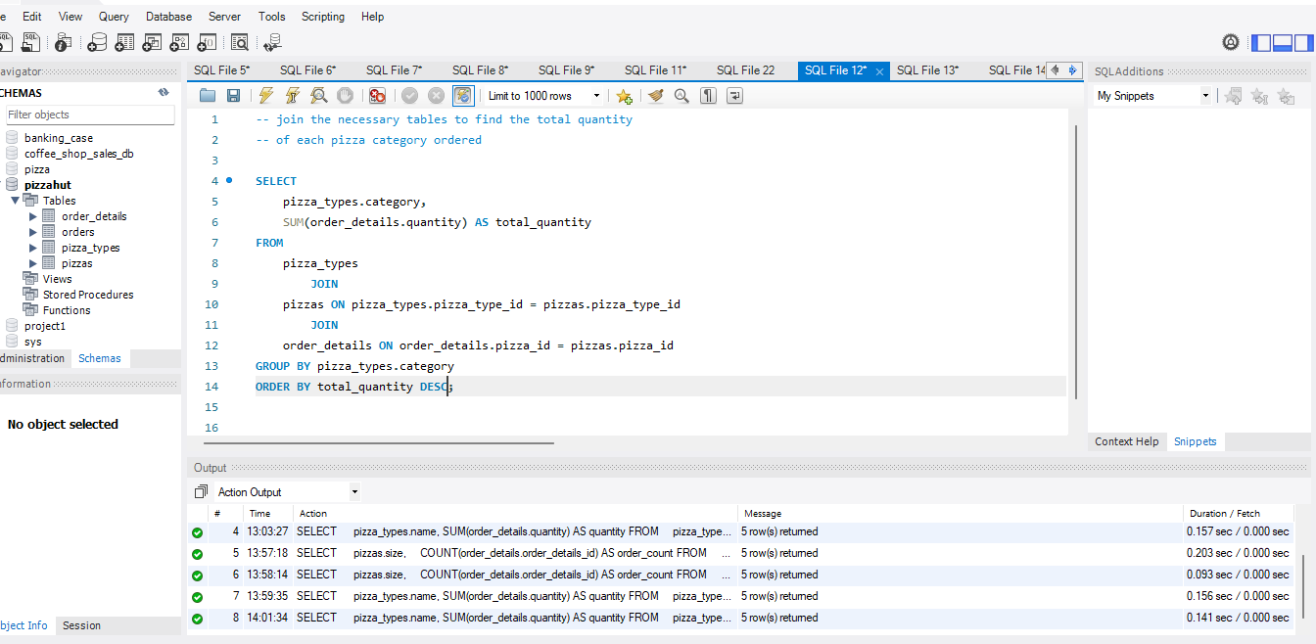
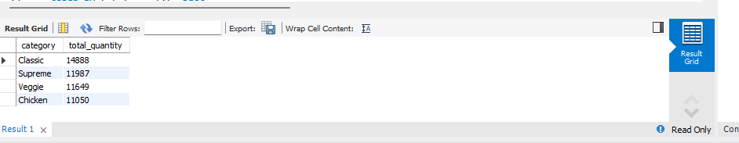
1 . Join the necessary tables to find the total quantity
of each pizza category ordered.
Query:
ORDER
NOW
Output:

Slide 14
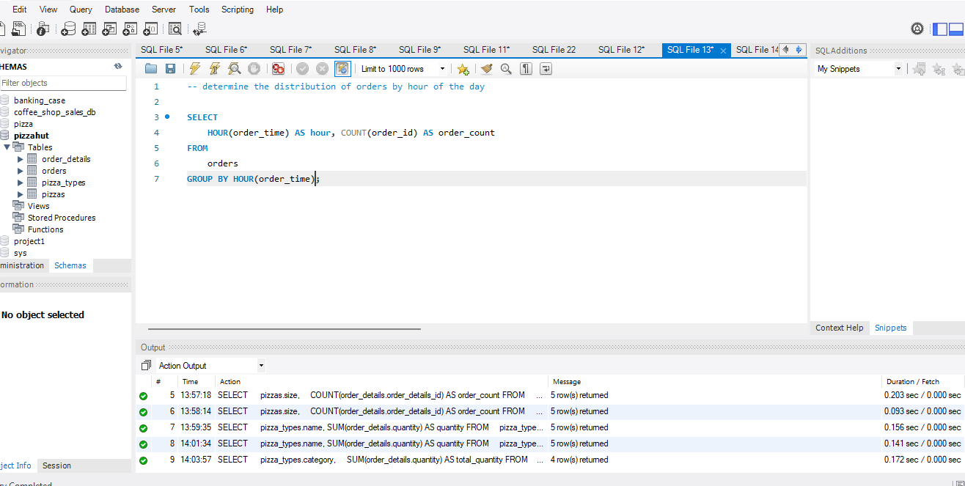
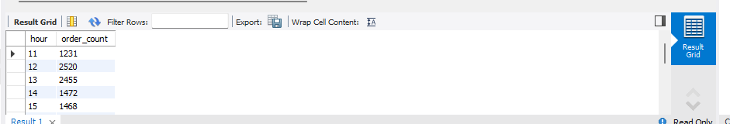
2 . Determine the distribution of orders by hour of the
day.
Query:
ORDER
NOW
Output:

Slide 15
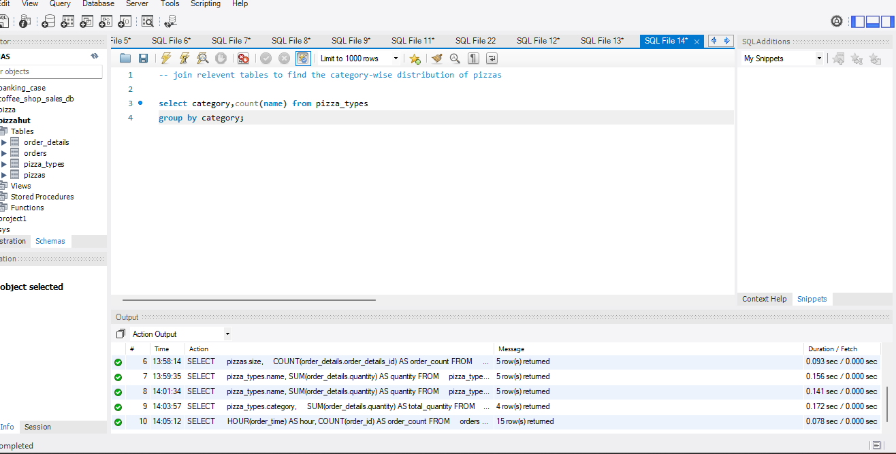
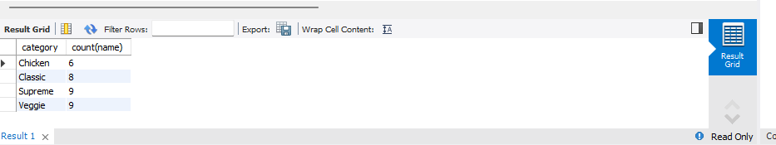
3 . Join relevant tables to find the category-wise
distribution of pizzas.
Query:
ORDER
NOW
Output:

Slide 16
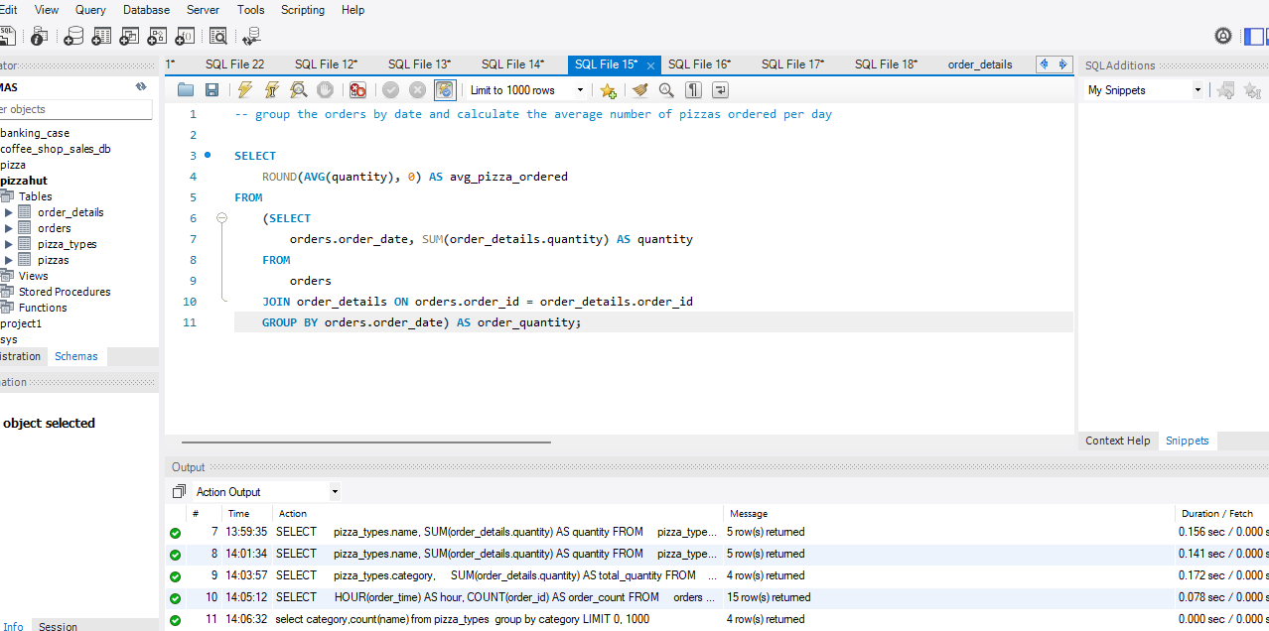
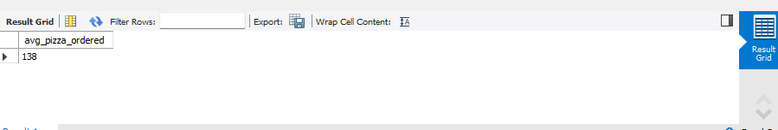
4 . Group the orders by date and calculate the average
number of pizzas ordered per day.
Query:
ORDER
NOW
Output:

Slide 17
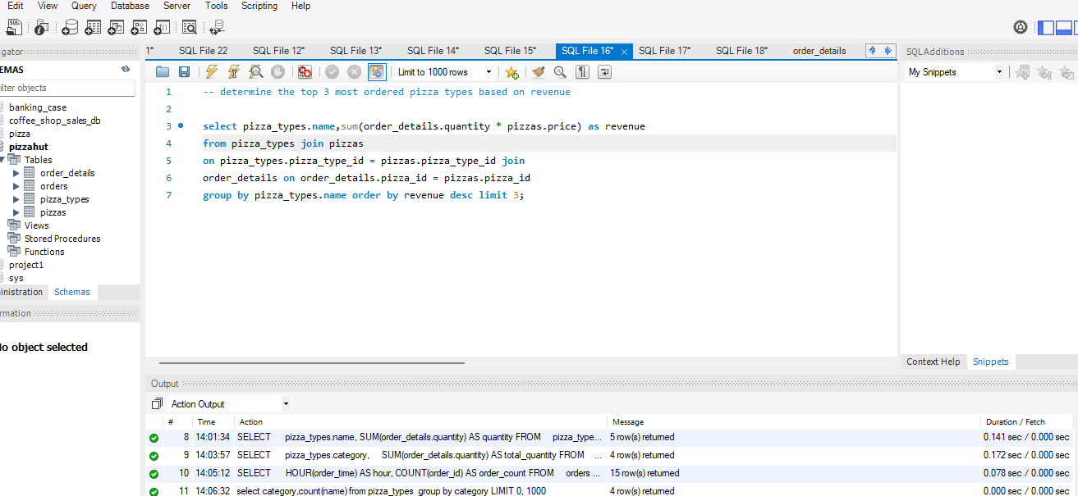
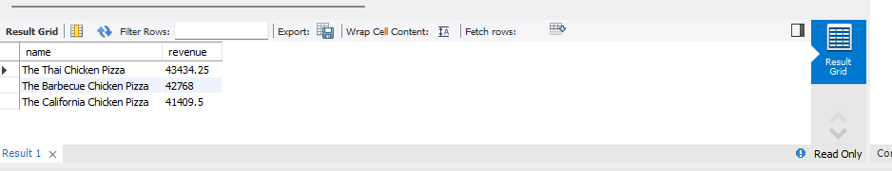
5 . Determine the top 3 most ordered pizza types based
on revenue..
Query:
ORDER
NOW
Output:

Slide 18
advanced QUESTIONS

Slide 19
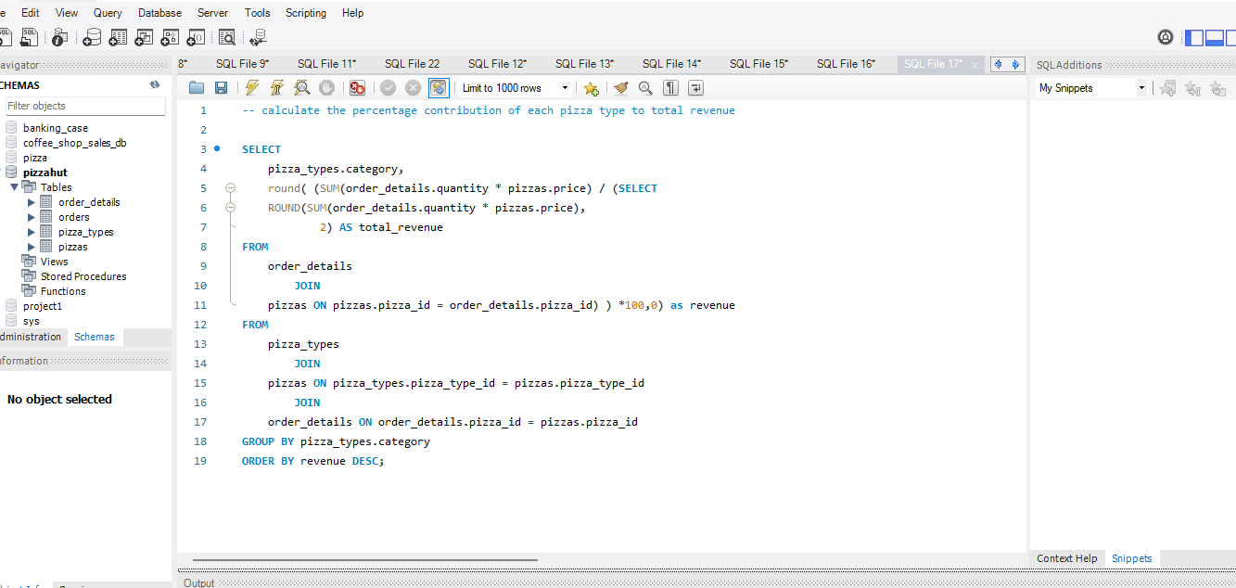
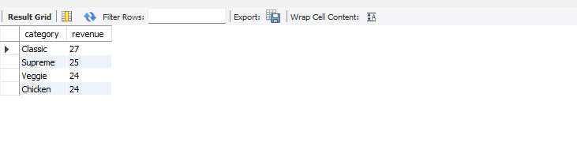
1 . Calculate the percentage contribution of each pizza
type to total revenue
Query:
ORDER
NOW
Output:

Slide 20
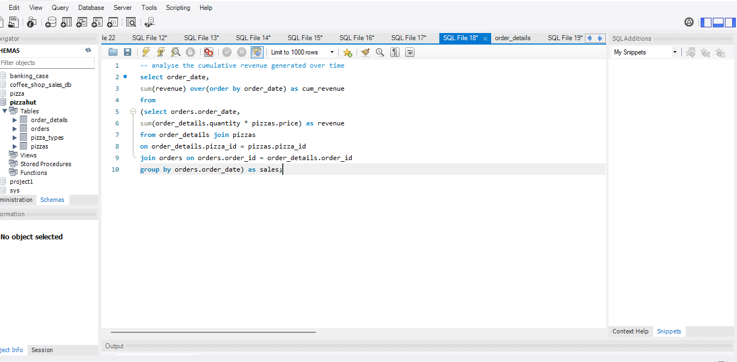
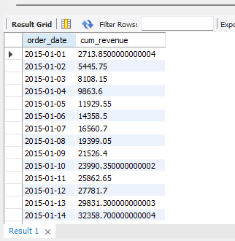
2 . Analyze the cumulative revenue generated over
time.
Query:
ORDER
NOW
Output:

Slide 21
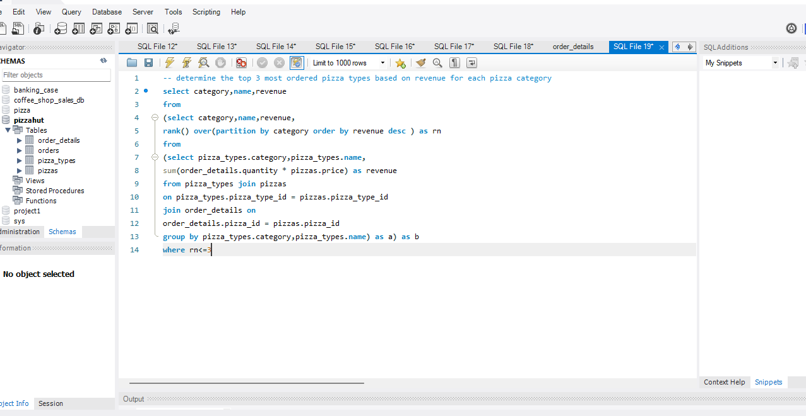
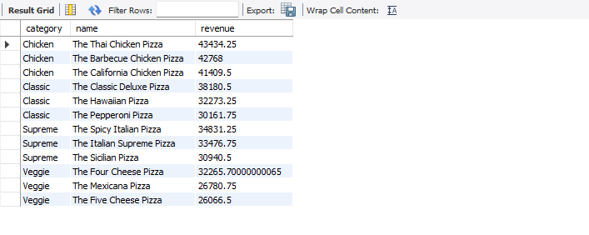
3 . Determine the top 3 most ordered pizza types based
on revenue for each pizza category.
Query:
ORDER
NOW
Output:

Slide 22
THANK YOU

